Slide 1



Aspect-Based Sentiment Analysis Methods for Analysis of Airlines Passengers Reviews
Jade Arpaliangeas
Supervised by Stéphane Malkawi

Slide 2

Presentation of the study
Objective: finding a model able to detect airlines’ aspects of service and detect reviewer’s sentiment polarity
(No available and documented model for this purpose)
Outline of presentation:
Data Description
Previous works on ABSA
ABSA on airlines passengers reviews
Aspect Extraction
Aspect Sentiment Analysis (Sup and Unsup)

Slide 3
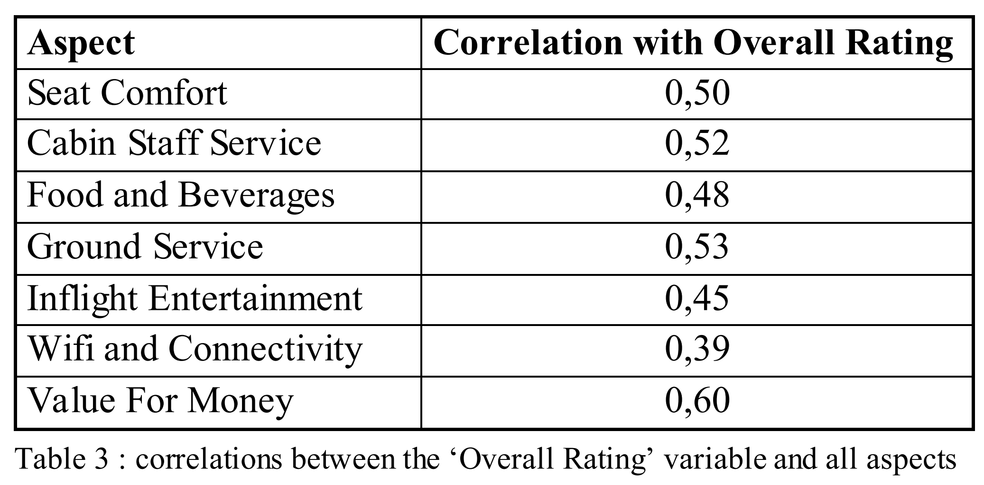
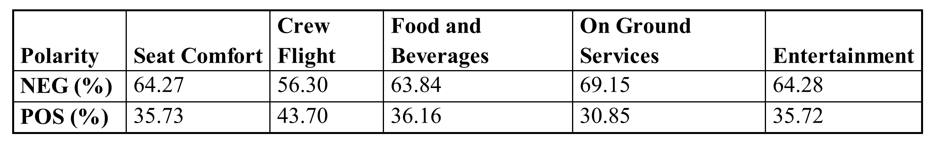
Data description - 1
110 156 reviews scraped from Skytrax
109 966 reviews after cleaning (100 000 for training)
Important variables:
Textual review
Overall Rating (1-10 stars)
Ratings by aspect of service (Food and Beverages, Cabin Staff/Crew Flight, On ground Services, Entertainment, Seat Comfort, Value for Money, Wifi and Connectivity) (1-5 stars)
Correlations ~0.5 << 1
Need for ASBA
Mostly negative reviews

Slide 4
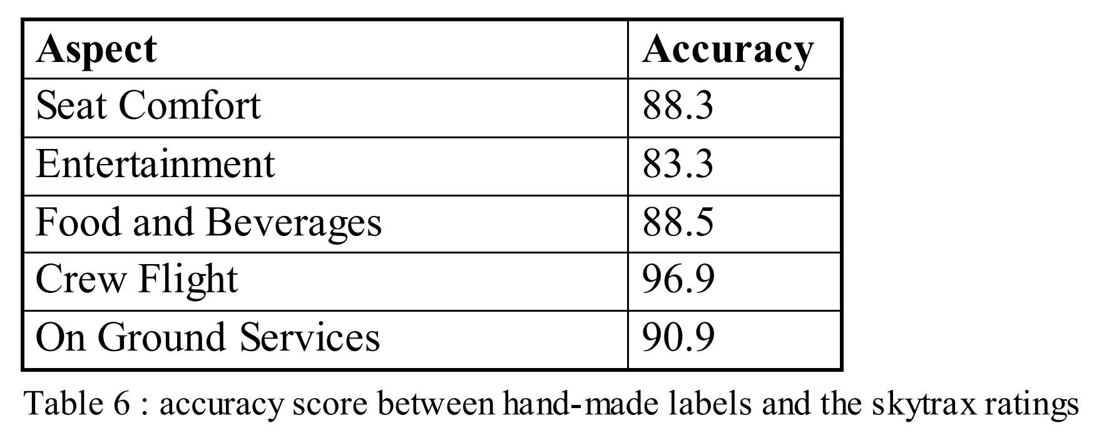
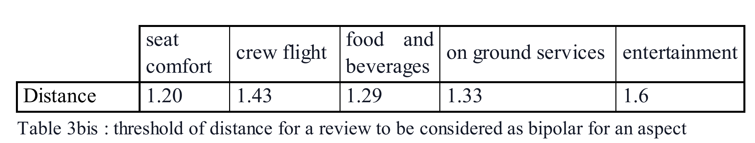
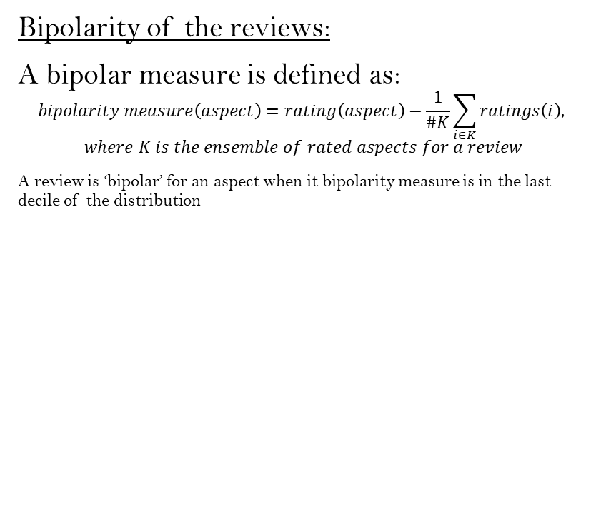
Data description - 2
Test set:
304 hand-made labels for all aspects
→ Accordance of test set with skytrax ratings
→ Justify use of skytrax ratings for ASC
Bipolarity of the reviews:
A bipolar measure is defined as:
$$bipolarity measure\left(aspect\right)=rating\left(aspect\right)−\frac{1}{\#K}\sum_{i∈K}{ratings\left(i\right),}$$
$$where K is the ensemble of rated aspects for a review$$
A review is ‘bipolar’ for an aspect when it bipolarity measure is in the last decile of the distribution

Slide 5
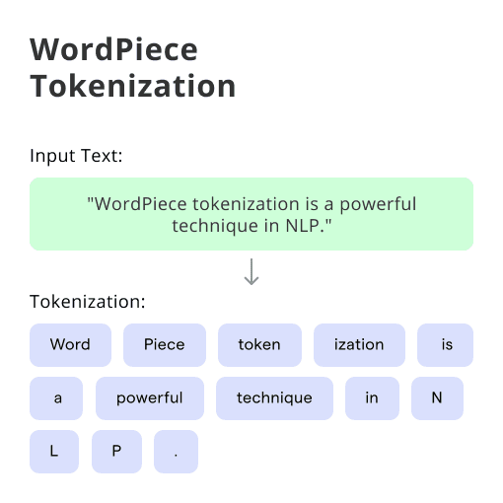
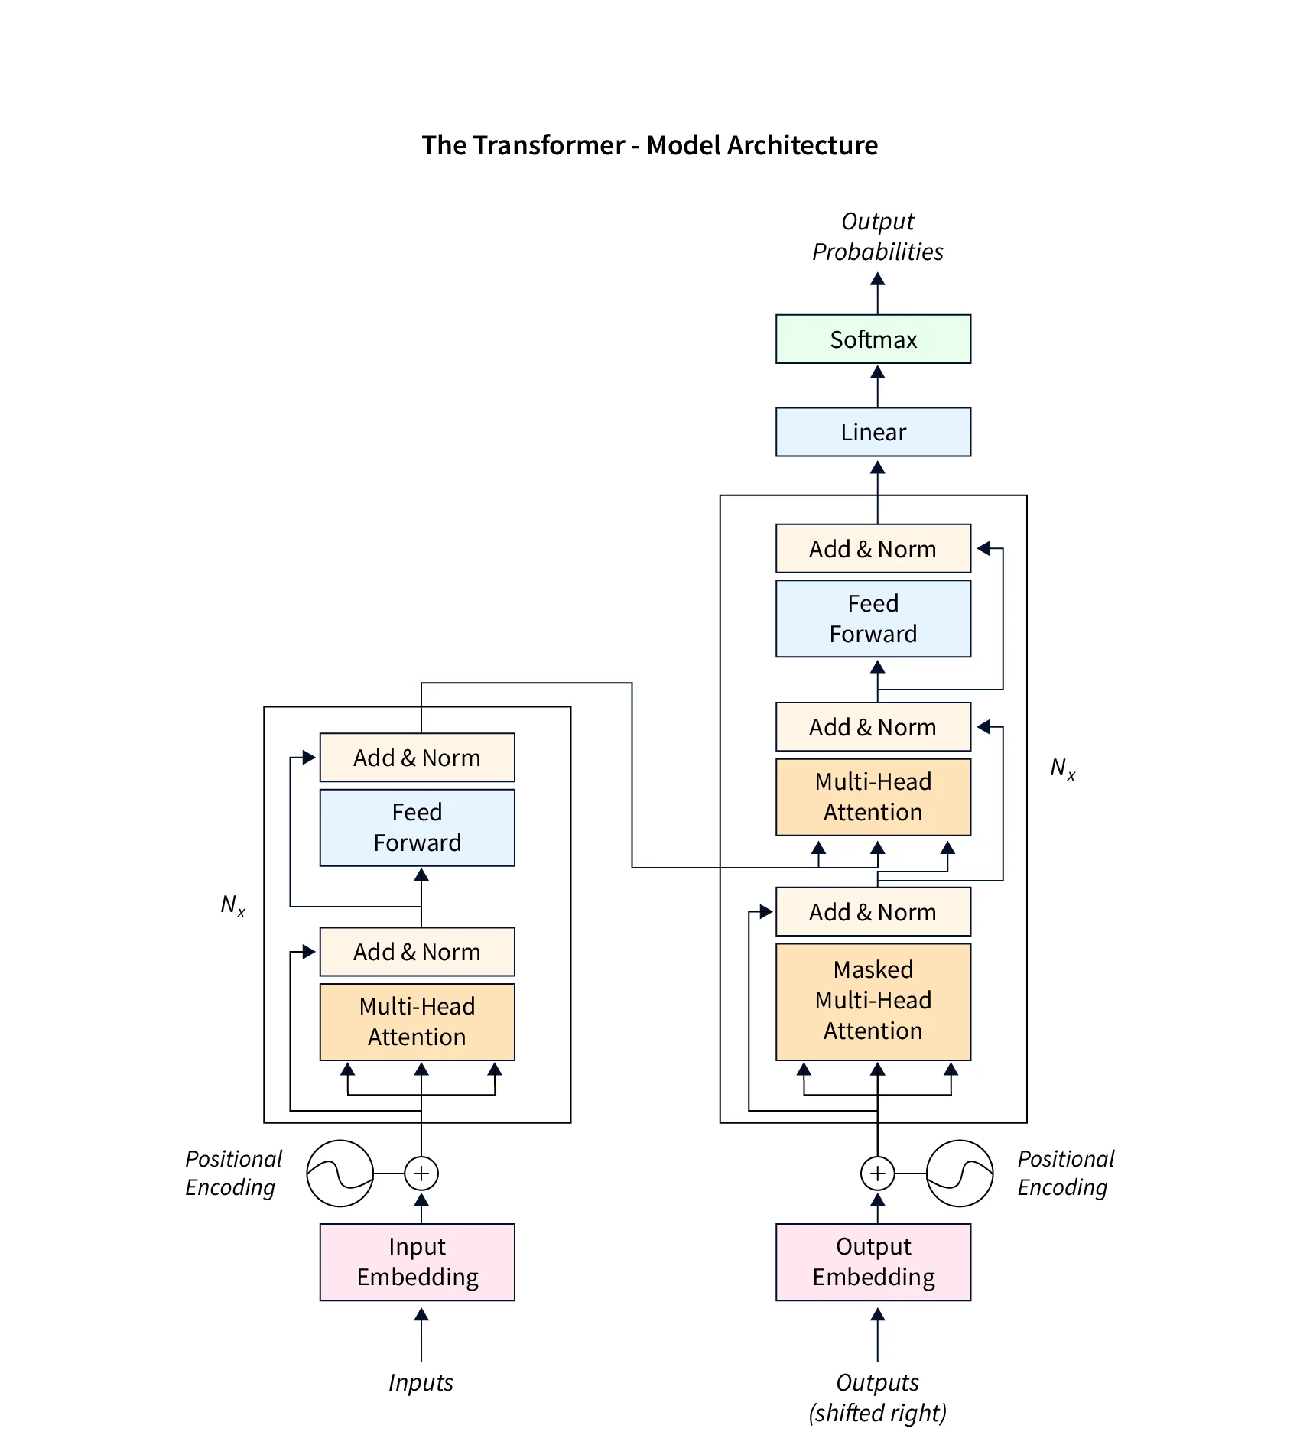
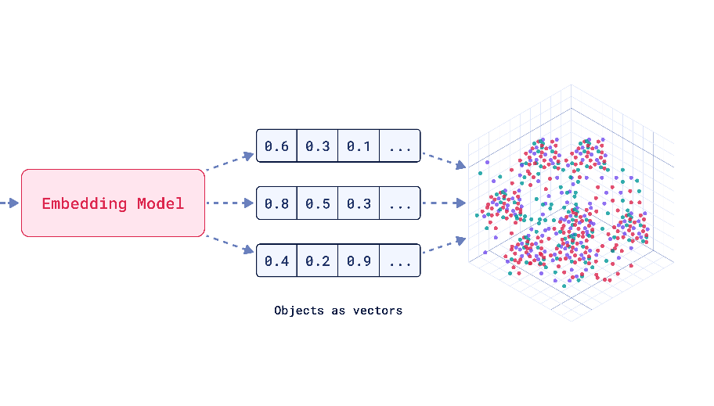
Basic NLP Concepts
Tokenization
Embeddings
Transformers
BERT (Bidirectional Encoder Representations from Transformers):
12 transformers with 12 attention heads.
Can be fine-tuned for downstream tasks (Sentiment Analysis, question answering,…)

Slide 6
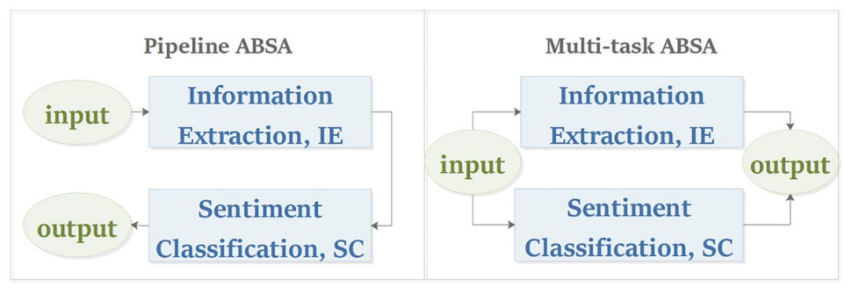
Literature review - 1
Aspect Extraction (AE):
“The food is so good and so popular that waiting can really be a nightmare.”
→ Opinion Term Extraction vs Aspect Category Detection
Using CNN, RNN or SVM… (supervised) or topic modeling (unsupervised)
Aspect Sentiment Classification (ASC):
→ To predict the polarity of sentiment per aspect
Using LSTM, BERT, Self-Attention… or lexicon-based / rule-based models

Slide 7
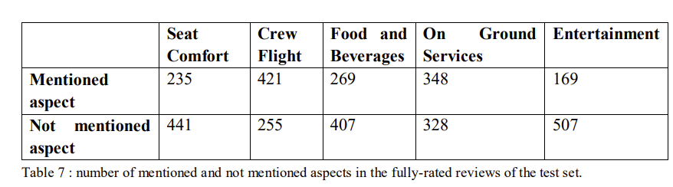
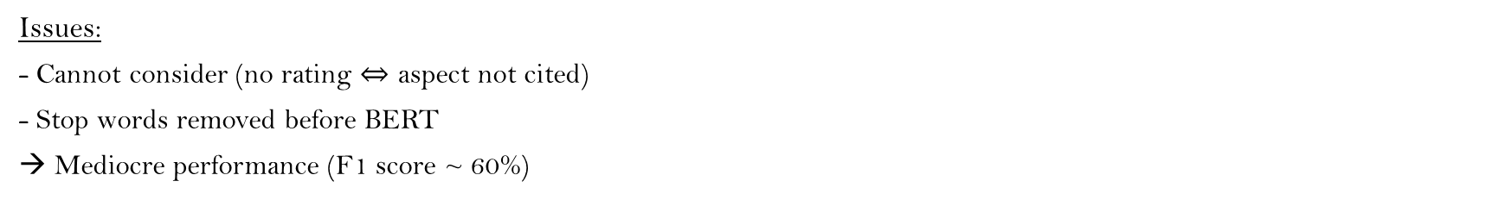
Literature review - 2
Predicting aspect-based sentiment using deep learning and information visualization: The impact of COVID-19 on the airline industry by Yung-Chun Chang et al. (2022)
Tripadvisor Data on 8 aspects (2016 -2020), Multi-task ABSA:
Input
Model architecture
Output
Skytrax ratings:
4/5: ‘POS’
NaN: uncited aspect
Softmax function
1 to 3 stars: ‘NEG’
Probabilities of 3 classes, for 8 aspects
Token, positional + ‘linguistic embeddings’
BERT-base
Dense layers gradually decreasing from size 768 to 24
Issues:
- Cannot consider (no rating $⇔$ aspect not cited)
- Stop words removed before BERT
→ Mediocre performance (F1 score ~ 60%)

Slide 8
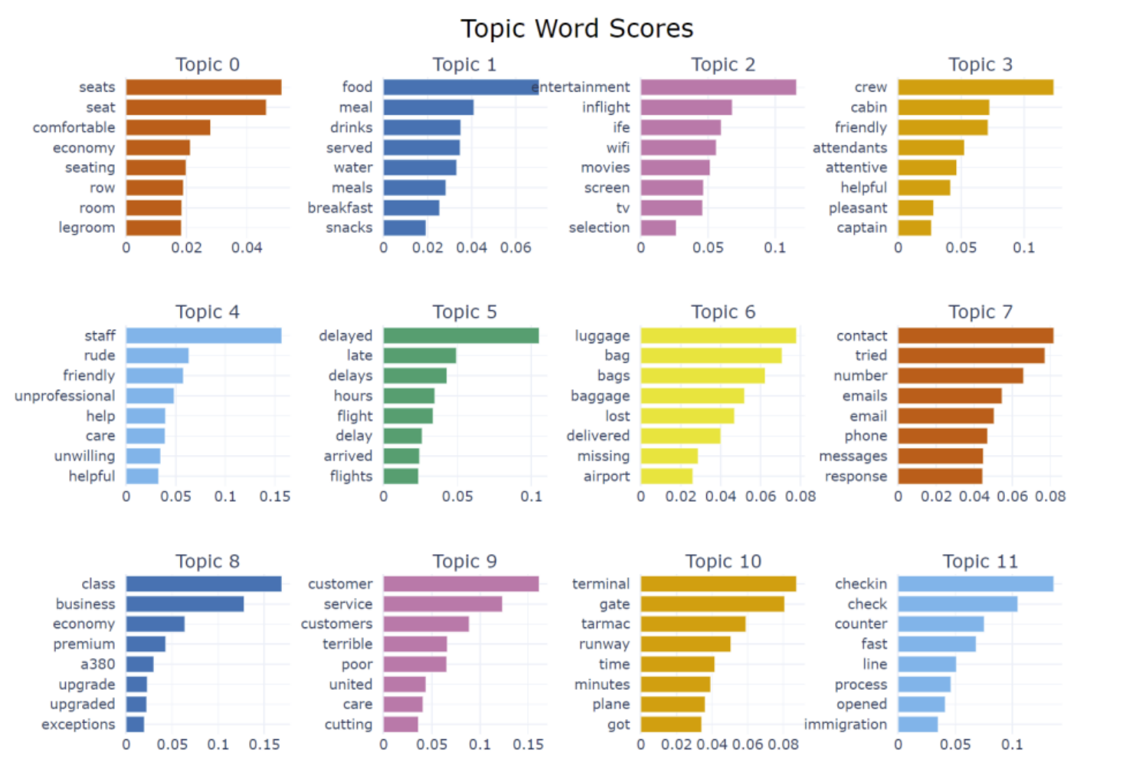
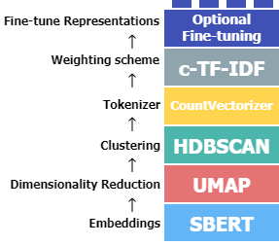
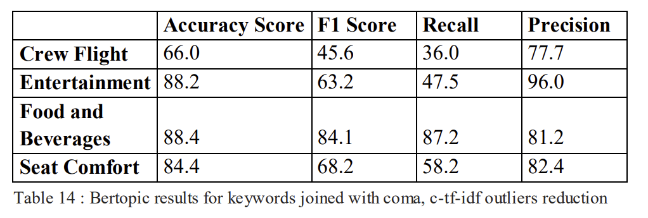
Aspect Extraction - BERTopic
(Mini-LM model)
BART model
Reviews divided by sentences
Improvement Attempts:
Outliers reduction (tf-idf)
Various keywords for BART model
Mini-LM further training
…

Slide 9
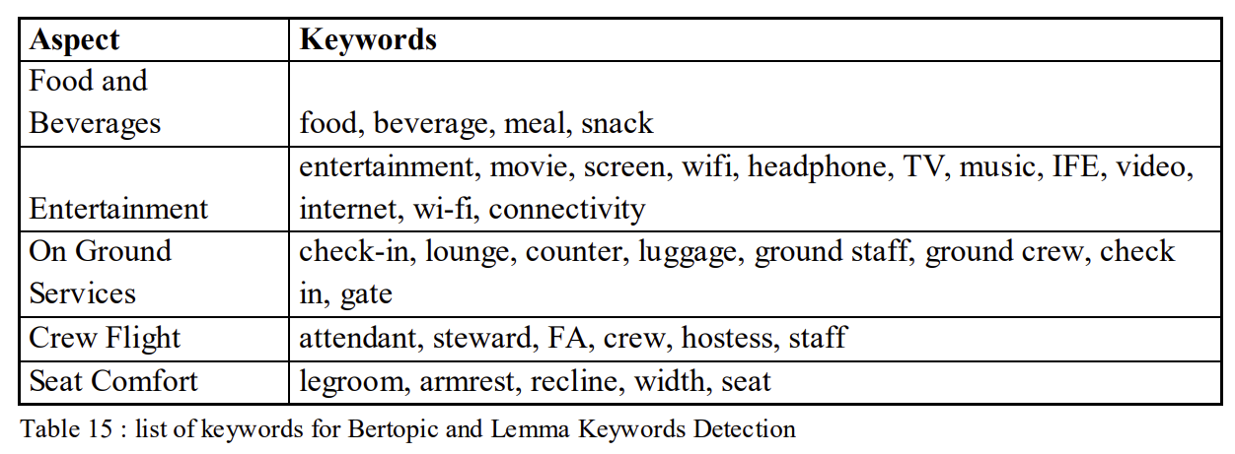
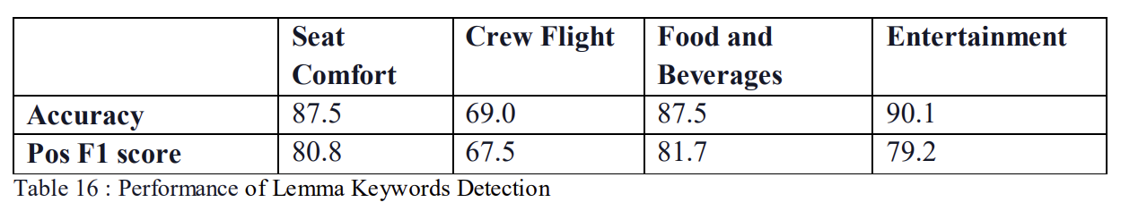
Aspect Extraction – Lemma Keywords Detection
Lemmatize sentence
Check list of Keywords, for each aspect
keyword detected = mentioned aspect
Better results than BERTopic, less instability
Output of LKD as input for next ASC models
Drawbacks:
False negatives
Bias/lack of generalization for the ASC models

Slide 10
Aspect Sentiment Classification - Baseline
The task:
Input of ASC : LKD predicted sentences for each aspect
Output: 0 (1-3 skytrax stars) or 1 (4-5 stars)
→ Binary classification Task
Baseline model:
‘’yangheng/deberta-v3-base-absa-v1.1’’ model from HuggingFace, based on BERT.
Trained on: Laptop, Restaurants, Yelp reviews…
Good enough overall, but hard time with bipolar reviews
Baseline model |  | bipolar | overall
Seat Comfort | Accuracy | 0.687 | 0.866
 | F1pos | 0.578 | 0.887
 | F1neg | 0.751 | 0.836
 | F1 macro | 0.664 | 0.861
 | test size | 182 | 500
Crew flight | Accuracy | 0.518 | 0.814
 | F1pos | 0.473 | 0.796
 | F1neg | 0.555 | 0.829
 | F1 macro | 0.514 | 0.812
 | test size | 309 | 500
Food and beverages | Accuracy | 0.670 | 0.860
 | F1pos | 0.308 | 0.839
 | F1neg | 0.783 | 0.876
 | F1 macro | 0.545 | 0.858
 | test size | 218 | 500
On ground services | Accuracy | 0.757 | 0.886
 | F1pos | 0.316 | 0.807
 | F1neg | 0.852 | 0.919
 | F1 macro | 0.584 | 0.863
 | test size | 267 | 500
Entertainment | Accuracy | 0.529 | 0.792
 | F1pos | 0.319 | 0.758
 | F1neg | 0.640 | 0.818
 | F1 macro | 0.480 | 0.788
 | test size | 136 | 500

Slide 11
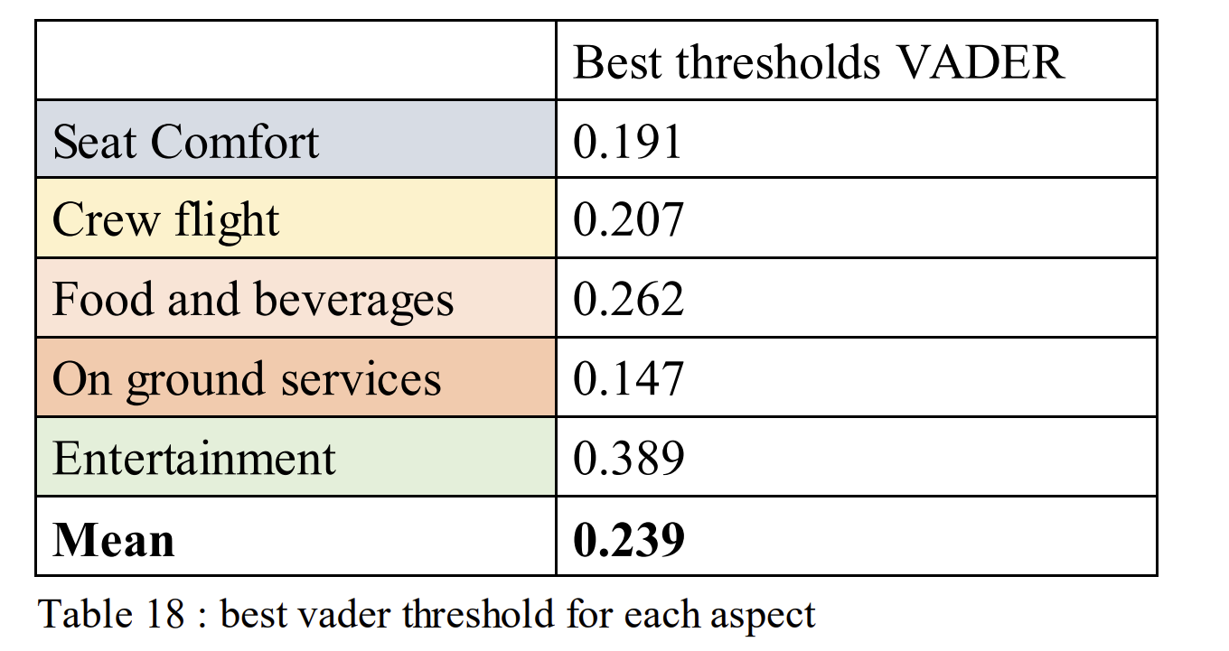
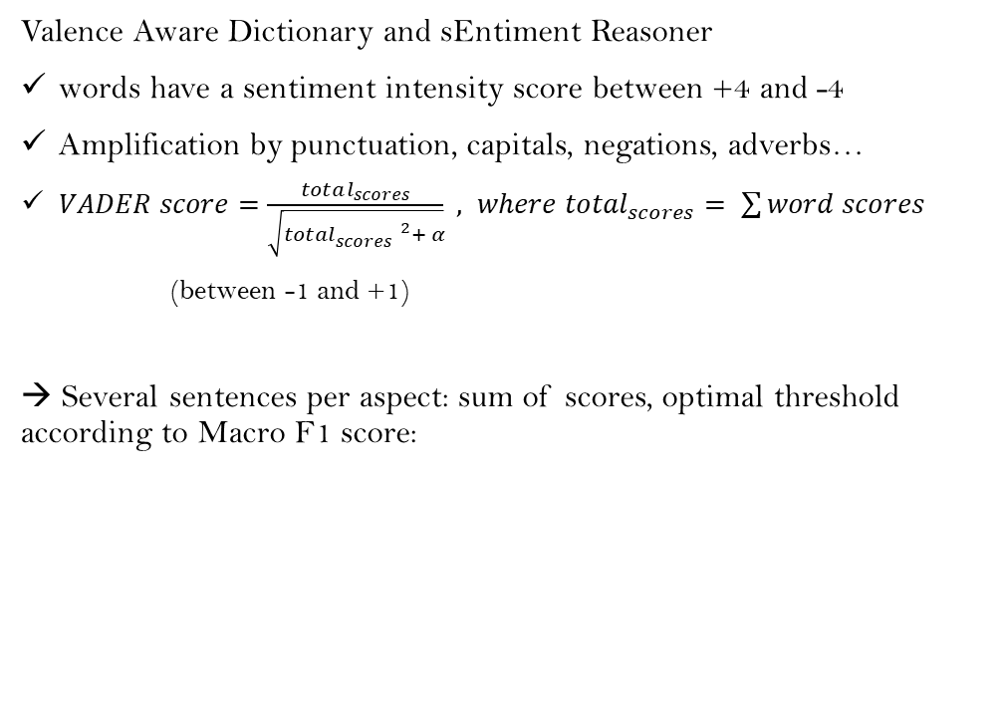
Aspect Sentiment Classification - VADER
VADER Results vs Baseline |  | bipolar | overall
Seat Comfort | Accuracy | 0.705 | 0.764
 | F1pos | 0.579 | 0.699
 | F1neg | 0.773 | 0.806
 | F1 macro | 0.676 | 0.752
 | test size | 555 | 3486
 | F1 macro baseline | 0.664 | 0.861
Crew flight | Accuracy | 0.553 | 0.763
 | F1pos | 0.567 | 0.735
 | F1neg | 0.538 | 0.786
 | F1 macro | 0.552 | 0.760
 | test size | 1279 | 6313
 | F1 macro baseline | 0.514 | 0.812
Food and beverages | Accuracy | 0.777 | 0.767
 | F1pos | 0.506 | 0.729
 | F1neg | 0.856 | 0.797
 | F1 macro | 0.681 | 0.763
 | test size | 435 | 3124
 | F1 macro baseline | 0.545 | 0.858
On ground services | Accuracy | 0.806 | 0.778
 | F1pos | 0.448 | 0.585
 | F1neg | 0.883 | 0.848
 | F1 macro | 0.665 | 0.717
 | test size | 629 | 3288
 | F1 macro baseline | 0.584 | 0.863
Entertainment | Accuracy | 0.635 | 0.726
 | F1pos | 0.391 | 0.698
 | F1neg | 0.739 | 0.712
 | F1 macro | 0.565 | 0.723
 | test size | 469 | 2174
 | F1 macro baseline | 0.480 | 0.788
Valence Aware Dictionary and sEntiment Reasoner
words have a sentiment intensity score between +4 and -4
Amplification by punctuation, capitals, negations, adverbs…
$VADER score=\frac{total_{scores}}{\sqrt{{total}_{scores}^{ 2}+ α}} , where to{tal}_{scores}= \sum{word scores}$
(between -1 and +1)
→ Several sentences per aspect: sum of scores, optimal threshold according to Macro F1 score:
→ Beats the baseline for bipolars only

Slide 12
Aspect Sentiment Classification - Supervised
1 dense layer
Model1
BERT-base
BERT embeddings
Dropout
[CLS] representation
Model2
3 dense layers + dropouts
Softmax
Size = 768
Size = 2
Model3
4 attention heads + 3 dense layers + dropouts (to modify)
Probability of class 1 = (‘POS’)
For crew flight and food and beverages

Slide 13
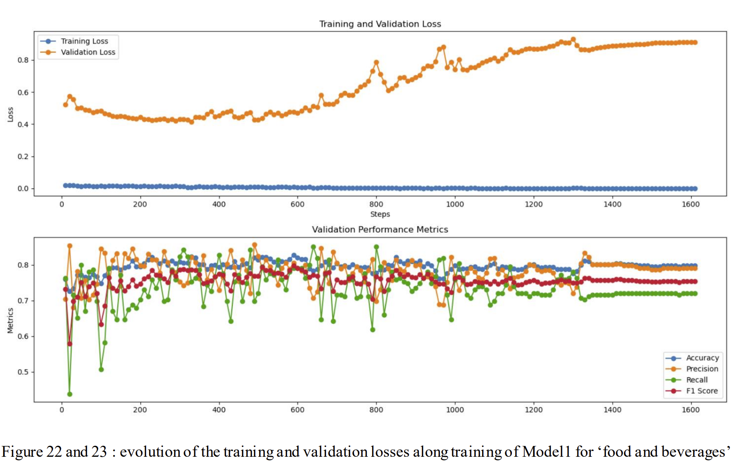
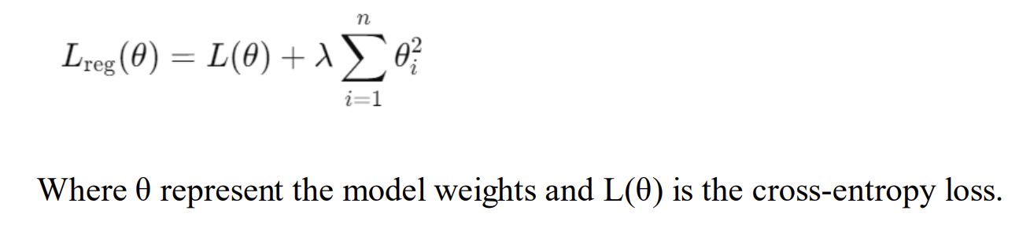
Aspect Sentiment Classification - Supervised
Training settings:
GPU Nvidia GeForce RTX 3050
Batch size = 32
Nb epochs = 5
AdamW optimizer
Training size = 10 000 sentences
Validation size = 500
Cross-entropy loss
Overfitting: an issue?
→ The probabilities of sentences are summed to create review prediction.
→ L2 regularization, λ = 0.01
Overfits less harshly but no improvement in results on single sentence. So we keep the model state with best validation accuracy

Slide 14
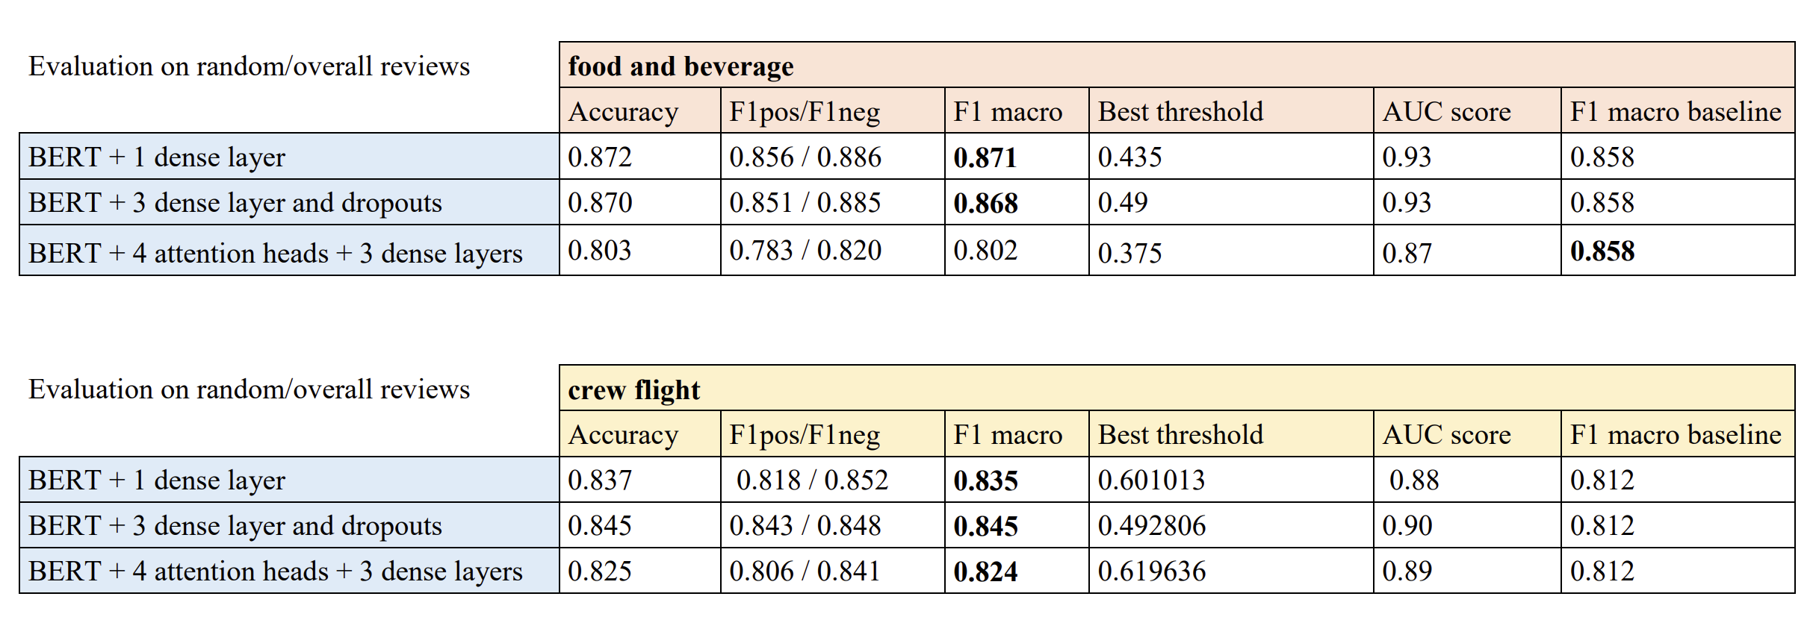
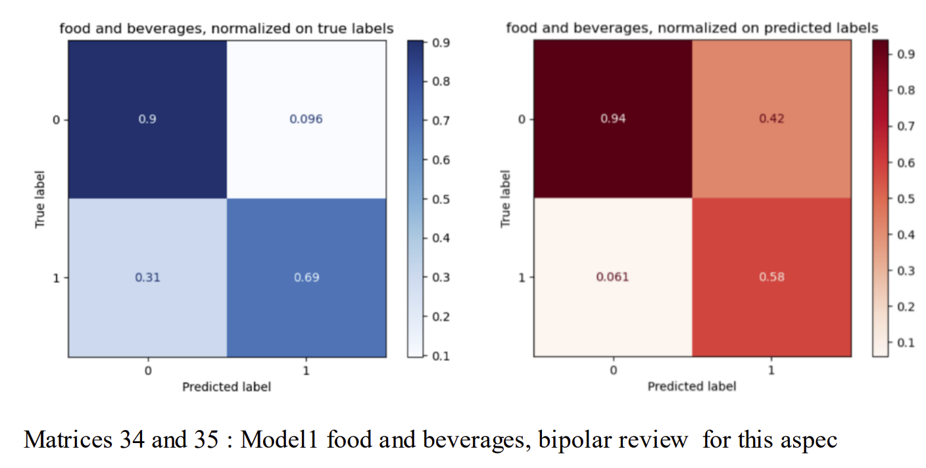
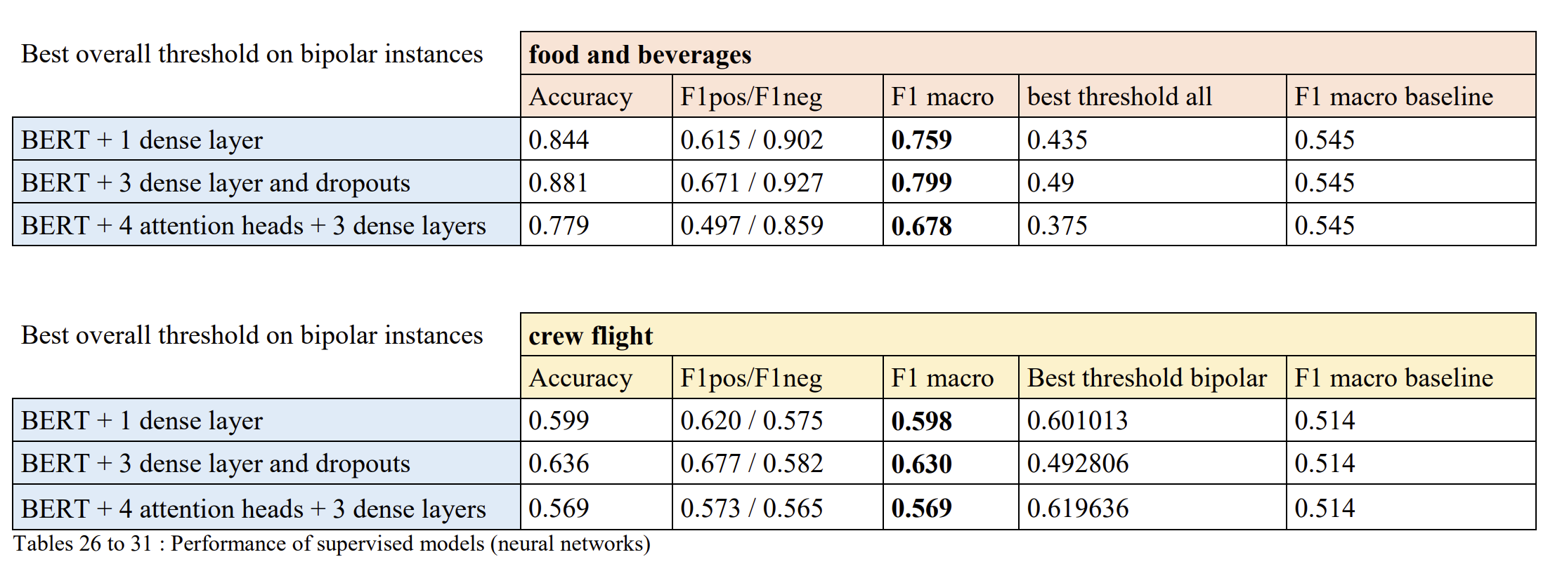
ASC Supervised - Results
Model1 and Model2 perform better
Almost all models beat the baseline
Real improvement for bipolar reviews

Slide 15
Conclusion
Objective:
Build AE and ASC models specialised for Airlines Passegers Reviews
What we did:
Scraped skytrax data
Set baseline
AE: Topic modeling (LDA, BERTopic) + Lemma Keywords Detection
ASC: Unsupervised + Supervised models (deep learning)
Beat the baseline
Possible improvements:
Improve BERTopic, test other topic modeling methods
GPT models
More data for Model3 + use token representations instead of CLS + parallel attention heads

Slide 16
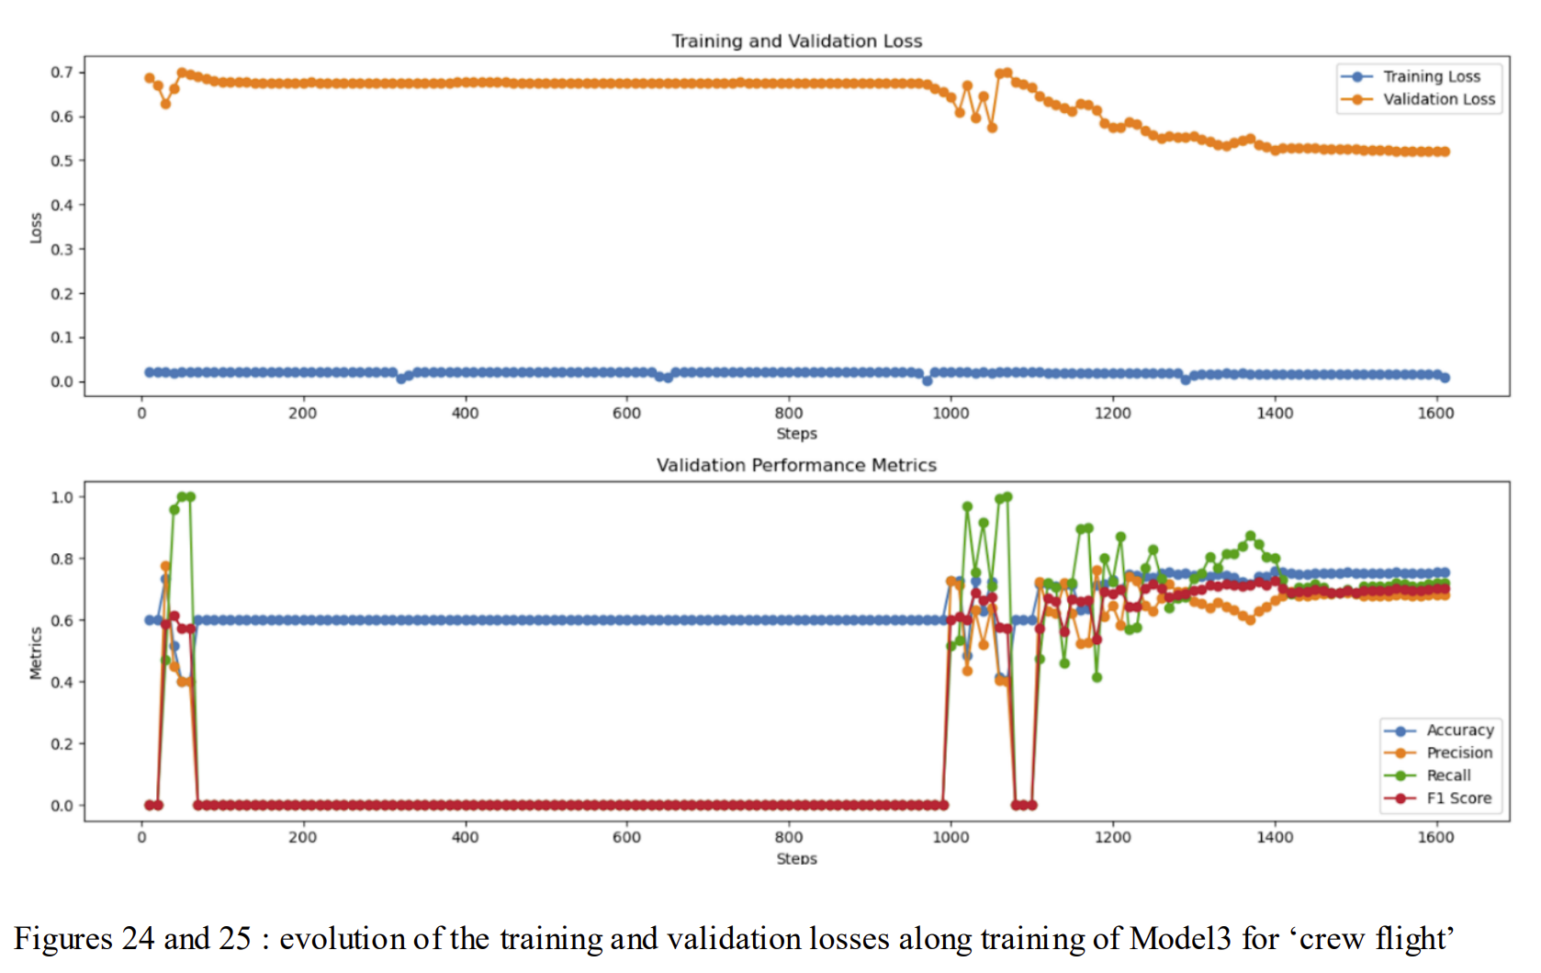
Aspect Sentiment Classification - Supervised
No fitting followed by large fluctuations: warmup for 250 steps

